Slide 1

Data Analytics Project
THE GLOBAL EV EVOLUTION ( 2010-2025 )
Analyzing Evolution of Electric Mobility and Future Adoption Projections
ASWATHI S NAIR
2026
15
50+
IEA 2026
Years of data
Countries
Data Source

Slide 2

Problem Statement & Dataset
Dataset
Source : International Energy Agency (IEA)
Data Coverage
50 + Countries
Years 2010- 2035
Vehicle types : Cars, Buses, Trucks, Vans, 2/3-wheelers
Powertrains: BEV, PHEV, EV (combined)
Metrics: Stock, Sales, Charging Points, Market Share
Why this dataset
I used to work in the automotive Industry I saw EVs becoming a big deal but never knew how big globally — so I used this data to find out.
How has global EV adoption evolved from 2010 to 2025, and which countries, vehicle types, and regions are leading the transition?
Questions ? :
How fast is the global EV is growing?
Which countries lead EV sales in 2025?
BEV vs PHEV — which is winning?
Is charging infrastructure keeping up?
What does 2035 look like?
Which vehicle segment leads the market across nations ?

Slide 3
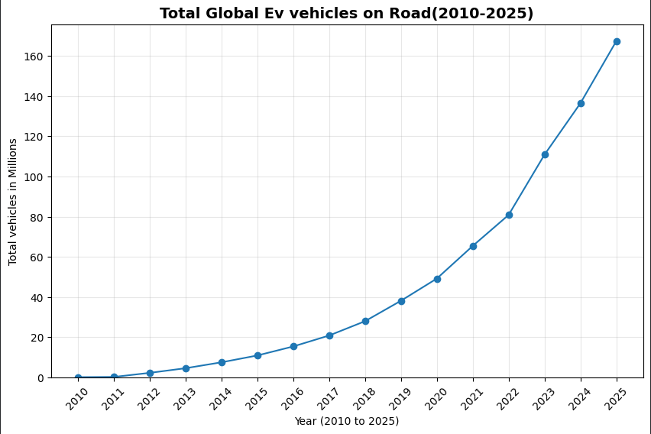
1) Total Global Ev growth(2020-2025)
​
Key Insights
Exponential growth
EV doubled roughly every 2 years from 2018 onward. 167.4M Ev's on road
Slow start
Under 1M vehicles globally until 2014. Early adoption was not there.
Post-2020 surge
COVID policy recovery + subsidies drove massive acceleration.
2025 milestone
~75 million EV Cars on the road worldwide.

Slide 4
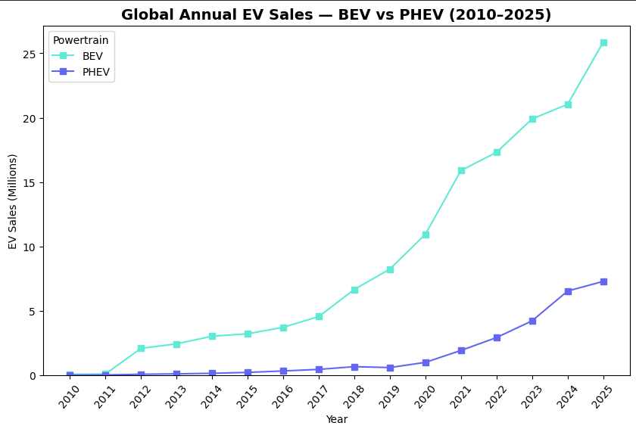
2) BEV vs PHEV: which is winning?
​
Key Insights
BEV is winning — Battery Electric Vehicles consistently outsell PHEVs from 2015 onward
The gap widens sharply after 2020, with BEV growing 3× faster than PHEV
PHEV growth has flattened, suggesting consumers are moving to fully electric rather than hybrid
By 2025, BEV accounts for the majority of all new EV sales globally

Slide 5
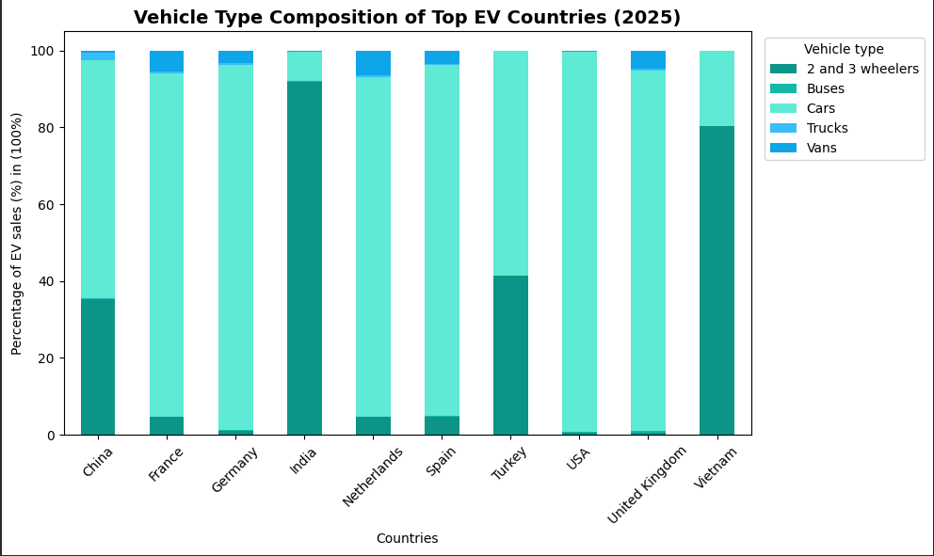
3)Vehicle Type Composition of Top EV Countries (2025
​
Key Insights
Cars dominate in Western countries (USA, Germany, France, UK) — near 100% of EV sales
India is unique — heavily dominated by 2 & 3-wheelers, reflecting local transport patterns
China has the most diversified mix — cars, 2-wheelers, and buses all present
Vietnam shows a strong 2-wheeler share, consistent with Southeast Asian mobility culture
This reveals that "EV" means very different things in different market

Slide 6
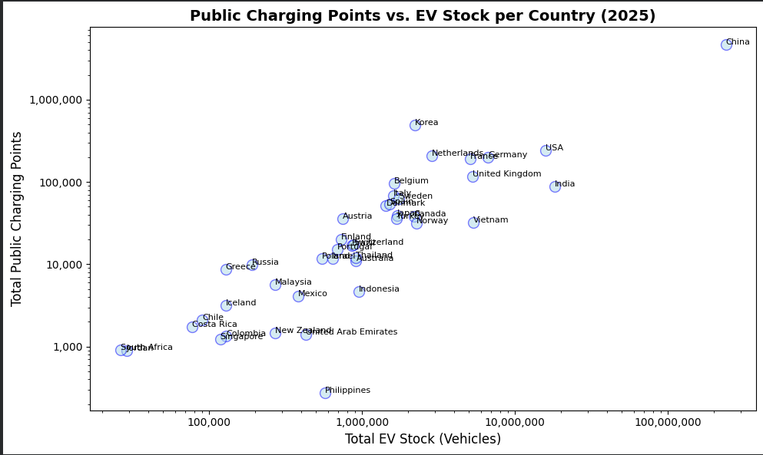
4)Public Charging Points vs EV Stock per Country (2025)
​
Key Insights
Strong positive correlation: countries with more EVs have more chargers — infrastructure is directly proportional
China is outliers at the top right — massive stock AND massive charging networks
Several European countries show high charger density relative to their EV stock — better infrastructure ratio
Some countries fall below the trend line — charging infrastructure lagging behind EV growth

Slide 7
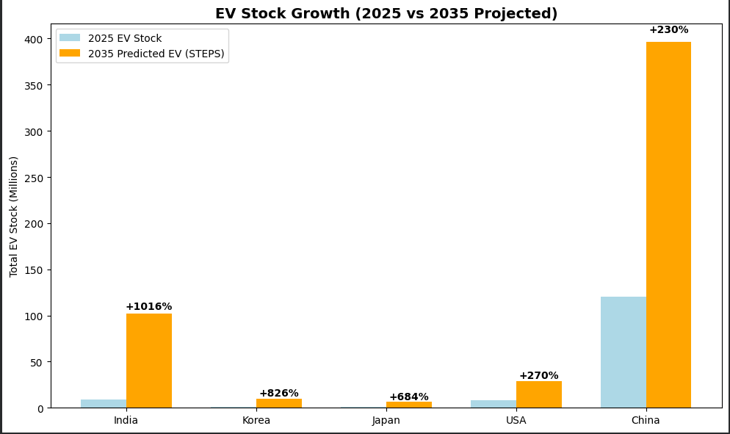
5)EV Stock Growth: 2025 Historical vs 2035 Projected (STEPS)
​
Key Insights
India leads in growth rate — projected +1016% increase from 2025 to 2035
Korea and Japan follow with +826% and +684% respectively — late starters with rapid acceleration ahead
USA projected +270% — strong but from a larger 2025 base
China +230% — slowest growth rate but still the largest absolute volume globally
countries with small current sales show massive future percentage growth, while mature markets show smaller percentage jumps despite adding far more physical cars.

Slide 8
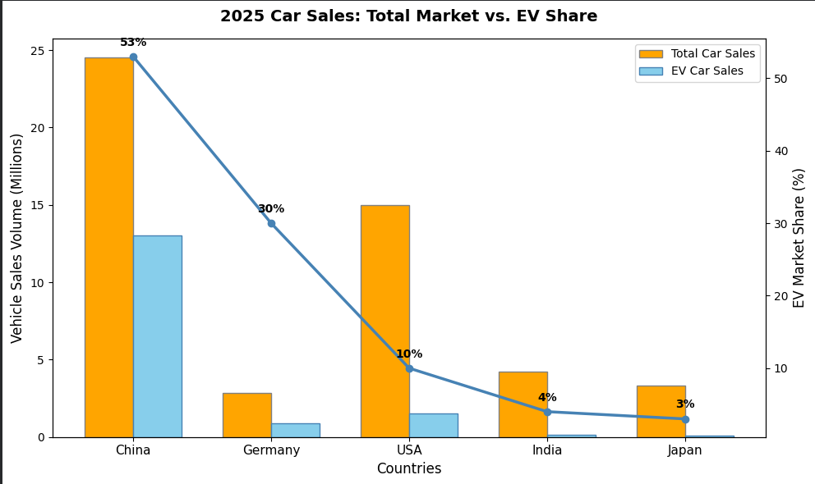
6)2025 Car Sales: Total Market vs EV Share
​
Key Insights
China leads EV market share — EVs are the highest proportion of total car sales
Germany has a high EV share despite a smaller total market — strong policy-driven adoption
USA has large total sales volume, but EV share is still relatively low — large room to grow
India and Japan have the lowest EV share — conventional vehicles still dominate
Market share % is a better measure of transition progress than raw sales volume alone

Slide 9
Ethical Considerations & Limitations
​
Ethical Considerations
Data is sourced from IEA — a credible intergovernmental body, but projections reflect policy assumptions .
Countries with weaker data infrastructure may be underrepresented — Africa, Middle East data is sparse
Presenting China's dominance without context could mislead — population and manufacturing scale must be considered
Limitations
Dataset covers only 50+ countries — many developing nations are missing
Oil displacement data has gaps (Car's data missing 2013–2014), 1078 country name rows missing
2035 projections assume policy targets are met — real outcomes may differ significantly

Slide 10
6)Conclusion & Future Works
​
Key Findings
Global EV adoption is real, accelerating, and irreversible — 167.4M EVs on road in 2025
China is the undisputed leader in both volume and growth; in growth Europe follows steadily
BEVs are winning over PHEVs — the future is fully electric
Infrastructure is keeping pace with adoption in leading markets.
Policies directly decides how fast the transition happens
Future work
Include CO₂ emissions data to measure actual environmental impact
Analyze battery cost vs sales growth — does price drop drive adoption?

Slide 11
Thank you!

